Slide 1



HLC Strategic Blueprint — From Belief to Practice
Workshop: a 6‑month (?) transformation roadmap aligning values, operations and parent experience to secure sustainable growth and deeper impact.

Slide 2

Where We Stand Today — The Decisions Before Us
Key trade-offs
Highlighted options
Every financial choice signals values: investment in people, place, or positioning.
Teacher salary +15% (₹2–3Cr/year); Fee increase 20–25% (~₹8–12Cr/year); Move to owned land (₹15–20Cr).
Smaller but meaningful moves
One‑time facility maintenance (₹50L); recurring maintenance (₹5L/year); value illustration campaign.
Unspoken question: Are these financial moves—or philosophical statements in disguise?
"Every spreadsheet decision is actually a values decision wearing a different suit."

Slide 3
Let's Decide What Comes First — Options & Immediate Next Steps
Fee Increase
Requires storytelling + visible upgrades. First step: map 12 demonstrable value points before announcement.
Bottom 5% Process
Requires clear, compassionate criteria. First step: define "fit" metrics and train counselors.
Parent‑as‑Advocate
Build Pride & referral mechanics. First step: create ambassador programme with recognition structure.
Teacher Salary Increase
Approve budget + rollout; announce and link to retention metrics.
Facility Maintenance
Vendor selection + timeline; approve ₹50L one‑time allocation this week.
Land Acquisition
Deferred to Month 6 — review with full financial picture and legal due diligence.
"Clarity precedes commitment. Let's leave here owning our choices."

Slide 4

The Story We're Trying to Tell
HLC belief: Curious learners become mindful leaders through everyday inquiry, social responsibility and holistic practice — not only isolated academic milestones.
Inclusion
Balance
10% seats for economically backward learners + 10% for differently‑abled learners; integrated, not separate.
Cambridge rigour balanced with life skills, sports and arts to build EQ, agency and character.
There was an error generating this image
There was an error generating this image
Tension: Fund sustainably while preserving access and quality. The answer begins with clarity.

Slide 5
Seeing Ourselves Through Their Eyes
Inside‑Out (Operations)
Outside‑In (Experience)
How we organise: efficiency, control, sustainability — ten core functions.
How it feels: trust, relationship, visible outcomes — what families actually pay for.
Critical insight: A school can be operationally excellent yet fail at delivering the perceived experience. Align metrics to what parents weigh in decisions.

Slide 6
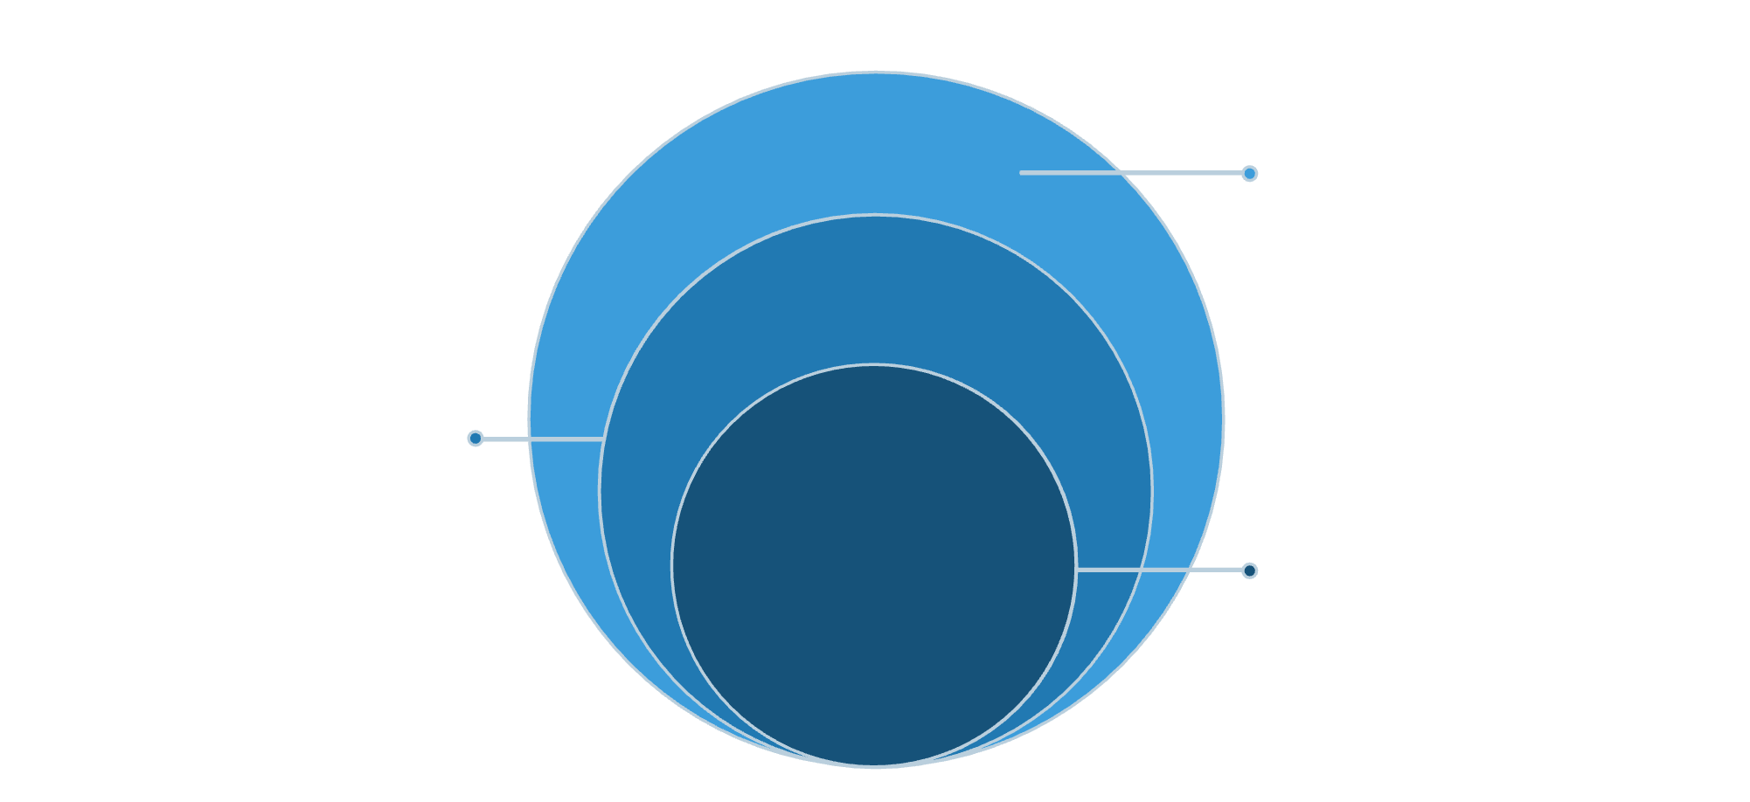
The Map That Guides Us — 180 Decision Points
Two perspectives × 10 parameters × 3 factor types = 180 decision factors across Strategic, Tactical and Operational layers.
Operational
Daily actions and execution
Tactical
Quarterly planning and milestones
Strategic
3–5 years, vision and priorities
Why it matters: most schools live tactically while hoping strategically. This framework forces coexistence and accountability across horizons.

Slide 7
How We Organise — Inside‑Out Parameters
Core Philosophy
Mission alignment with parents aspirations.
Finance
Fee structure, scholarships, endowment planning.
Marketing & Sales
There was an error generating this image
Authentic messaging to aligned families.
HR
Recruitment, retention and professional development.
Discussion prompt: Which 3 parameters have the largest execution gap?

Slide 8
What They Experience Every Day — Outside‑In Parameters
There was an error generating this image
There was an error generating this image
There was an error generating this image
Vision & Promise
Learning Environment
Communication & Partnership
Does the school walk its talk?
Does the school have what my child needs?
Will we be informed and heard?
Discussion prompt: Which 3 experiences, if strengthened, would most influence enrolment decisions?

Slide 9
When Operational Excellence Becomes Visible Value
The alignment test: for each Inside‑Out function, ask — how does this directly shape parent perception?
Finance → Value & Affordability
Learning Delivery → Academic Experience
Marketing → Communication
Fee increases require visible, communicated improvements to feel like value, not extraction.
Clear storytelling maps operational change to parent priorities.
Evidence of stronger outcomes and teacher stability must accompany pricing shifts.
Example: Fee increase only succeeds when paired with learning improvements, visible facility upgrades, and steady teachers.

Slide 10

HLC 3.0 — 6 Months / Nov End (?) to Move from Current State to Future State
Month
Focus
Key Deliverable
Owner
1
Foundation
Announce salary increase; staff philosophy workshop
Founders
2
Internal alignment
All‑staff immersion; communication toolkit
Principal
3
Value demonstration
Facility maintenance done; value campaign launched
GC
4
Parent engagement
Town hall; testimonial & referral push
Parent Council Lead (GC is there but PC?)
5
Selective transition
Bottom 5% review; aligned admissions
Academic Head + Admissions
6
Review & scale
6‑month assessment; XI–XII wing completion; land decision
Founders
Critical success factor: each month ends with an "alignment check" — did promised changes show up in family experience?

